Slide 1
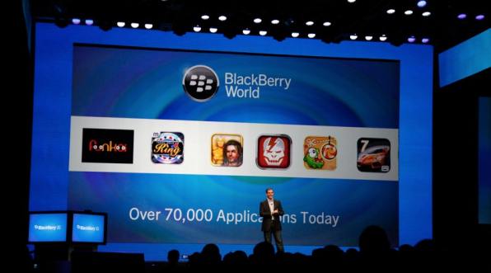
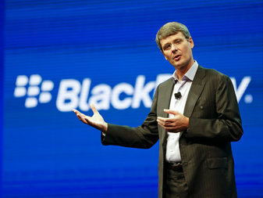
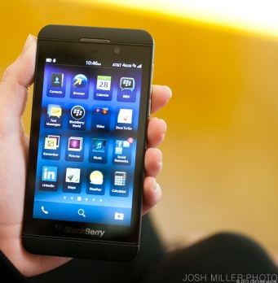
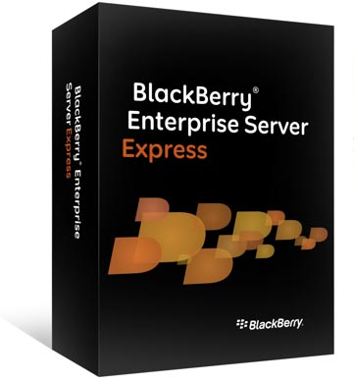



Blackberry Limited (TSX:BB)
Managing Turnaround Companies
October 23rd 2013
Team: Shashank Ramineni, Chethan Mittapalli, Amit Bhatia
Babson College, Two-year MBA Class of 2014

Slide 2

Agenda:
Situation Assessment
Introduction
Strategic profile – Key issues and root causes
Financial profile
Option Analysis
Options
Criteria for success
Recommendations
Turnaround plan
Execution issues and priorities
Timeline
Financial projections
How elements of Turnaround plan effect projections
Measures to measure turnaround success
Conclusion

Slide 3

The inventor of the modern ‘Smartphone’
Canadian maker of Wireless communication products formed in 1984
First product was the Blackberry pager in 1999
Launched phones which combined features of phone and PDA
Enterprise software and Security features
Undisputed leader of govt. and Business communication by 2000
Enters consumer market
‘’Fastest growing company in the world’’
-Fortune Magazine 2009
20% Smartphone market share
- 2009

Slide 4
4 years in Hell…
From a high of 85.9 USD/Share in 2009.... ......... .. to 8.40 USD/Share in 2013

Slide 5
45
Key strategic issues and causes
Key issues
Causes
Poor touch screen product line
Introduction of IPHONE - 2007
Emergence of Android
No Competitive Products
R&D failure
Management : Lack of Vision
Platform Ecosystem
Evolution of Ecosystem
Consumer’s changing preference
Application market migration way from BB
A negative halo begins to form
Poor R&D
Product failure
Disastrous foray into Tablet with Playbook
BYOD
Bring your own device (BYOD) permeates corporate world
Effects hardware and enterprise sales
Lack of applications for other platforms
Corporate customers – the most profitable segment – begin to migrate
Aging Network
BB suffers massive global outages
Information delivery delayed infuriating corporate clients
Inability to compete with 4g/LTE networks
Out-dated Network Technology
Low end Market
Inability to capture lower end market
Inability to adapt to growing Smartphone industry
Out-dated inventory
Inability to compete in lower end market
Pricing
Source: Team analysis
Notes:
Poor Touch Screen:
Key Issues:
Apple introduced the I-Phone in 2007 and the world was never the same for BB
BB didn’t even have competitive products in the drawing board.
Android emerges to compound misery
Causes:
R&D failure
Management: Management initially down played the impact of touch screen
Low End Market:
Key Issues:
Firms like Nokia, HTC launched sub $200 Smartphone to capture the lower end market
BB’s lower end products could not complete with these smart phones
Causes:
Product portfolio not refreshed quickly to combat market forces
Competitors ate away the lower end consumer smartphone market
Platform Ecosystem
Key Issues:
Smartphones were no longer a completely stand alone market
Consumer’s buying choices were influenced by degree of integration amongst Notebook, Tablet and Smartphone
Application market migration way from BB
Disastrous foray into Tablet with Playbook
A negative halo begins to form
Causes:
Poor R&D
Product failure
BYOD:
Bring your own device (BYOD) permeates corporate world
About 75% of employees in high growth markets such as Brazil and Russia and 44% in developed markets already using their own technology at work
Effects hardware and enterprise sales
Causes:
BB does not release software which can accommodate new landscape
Corporate customers – the most profitable segment – begin to migrate
Aging Network:
BB suffers massive global outages
Information delivery delayed infuriating corporate clients
Also an aging network is struggling to compete with 4G/LTE
Causes:
A network based on outdated technology weighs BB more
Give corporate clients more reasons to switch

Slide 6
Income Sheet effects….
REVENUE
REVENUE SEGMENTATION
EBITDA
BB’s top line has shrunk 30% CAGR in last two years, while EBITDA shrank by 82.4%…
…2012-13, deferred revenue increased 279M; distributors now sell through ...
…$752M in losses on Inventory provisions from Playbook and BB7….
While all revenue segments declined, Software is propping up the numbers…
…52% drop in Hardware sales in FY2013 with a 106% drop in margins...
….Hardware sales will eventually hit software sales unless turned around….
Notes:
Gross Margins:
USD Millions 2013 2012 2011 2013 2012 2011
Hardware and others Service and software
Revenue 6,902 14,031 16,416 Revenue 4,171 4,392 3,491
Cost of sales 7,060 11,217 10,516 Cost of sales 579 631 566
Gross Margin -158 2,814 5,900 Gross Margin 3,592 3,761 2,925
% Change yoy -106% -52% % Change yoy -4% 29%
New Hardware revenue declined (52%) y-o-y ; Gross margins declined (106%) y-o-y to touch (158)M
Service revenue are continued receipts from multi year contracts TCO. The service margins while declining (4%) to $3.5B still propped up the overall margins.
However it is prudent to note that the declining hardware sales will eventually hit the Service revenues once the TCO of aged multi-year contracts begin to lapse
Many customers switched to the sell-through method of revenue recognition; when distributors resell products to end-users (sell-through) reflecting struggle re-sell RIM products
RIM also recorded losses on Inventory provisions because of its aging product platform which has suffered in a fiercely competitive market.
During fiscal 2012, the Company recorded pre-tax provisions on its inventory of $752 Million (on BlackBerry PlayBooks of approximately $485 million and on BlackBerry 7 smartphones of approximately $267 million)

Slide 7
RIM in red, though no debt…
 | Altman Z score
2009 | 17.13
2010 | 12.44
2011 | 8.7
2012 | 5.6
2013 | 2.7
LTM | 2.3
WC/ TOTAL ASSETS
Liquidity wrt to size
SALES/ TOTAL ASSETS
RETAINED EARNINGS/
TOTAL ASSET
Total asset turnover
ALTMAN Z SCORE
Profitability that reflects age
And earning power
MARKET VALUE/ BOOK VALUE
EBIT/ TOTAL ASSETS
Measures operating efficiency
Source: Expert interviews; team analyses

Slide 8
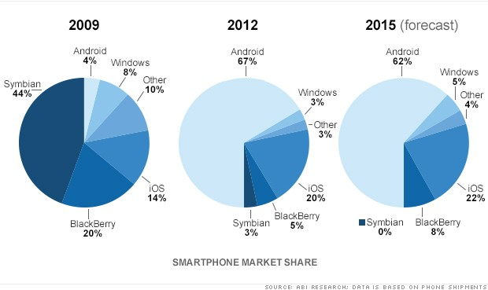
The nature of the beast…
2009
Blackberry faces a massive Market share Turnaround situation
2012

Slide 9
AGENDA
Situation Assessment
Introduction
Strategic profile – Key issues and root causes
Financial profile
Option Analysis
Options
Criteria for success
Recommendations
Turnaround plan
Execution issues and priorities
Timeline
Financial projections
How elements of Turnaround plan effect projections
Measures to measure turnaround success
Conclusion

Slide 10

Burning Fingers….
$2.3 bn
August 2013
March 2013
$2.6 bn
Cash
Burn Rate
Net Loss ($942M)
$300 Mn Cash burnt in 5 months
Time Left
18 Months

Slide 11
What exactly are Blackberry Options??
Liquidation
Cost Cutting
Acquisitions / Partnerships
Platform and Technology Innovation

Slide 12

Liquidation : end of the Road OR do we have time…?
Company can opt for Liquidation:
Investors : Putting pressure on Management
Devices : Hardware failure
Ecosystem : Failure to develop app market
Software : Failing due to decline in Hardware sales
Falling Market Share
Negative sentiment among investors and customers
Assets
Assets Worth$ 5.7 Billion
Healthy Patent and Intellectual Property Portfolio
Security Network
Enterprise Software
Cash : $2.6 Bn
Subscriber Base

Slide 13


Cost Cutting : Last option before giving up…...
Bleeding
Go PRIVATE
Methods in Place
CORE Program Implementation
Layover of Employees.
Reducing number of phone models
Results So far…..
May be delaying the inevitable.
Buying out more time.
Notes:
Preventing sensitive information from market.
Allows to buy more time to fix issues.
Arresting negative sentiments in market.
Reduce performance pressure on management and employees.
Reduction in costs due to being private.
Downside:
Limited access to raising capital in future.
Mammoth investor losses : around $80 billion in share value destruction.
operating as a non-SEC reporting company will reduce the burden on
management and employees that arises from SEC reporting requirements, thus allowing
management and employees to focus more of their attention on the company’s core
Business
Operating a non-SEC reporting company may eliminate the pressure and
expectation to produce short-term per share earnings and may increase management’s
flexibility to consider and initiate actions that may produce long-term benefits and
growth.

Slide 14



Acquisitions / Partnerships : Join hands….
Acquire
Strategic Alliance
Patent Portfolio Companies
For Newer Products
Faster and better products to Market
Paratek and Nortel
With Bigger giants for mutual growth
Amazon
Lenovo
Samsung
Facebook – HTC Alliance | NOKIA – Microsoft Alliance | Microsoft – LG
Notes:
Nortel – Another Canadian company
Amazon
Lenov- again expressesed interest
Samsung- InAfrica, blackberry is working with Samsung to promote BBM
Microsoft – LG : Feb 2009, LG came up with windows phone.

Slide 15


Platform and Technology Innovation
Platform
Develop Software apps for other platforms.
BBM on Android and IOS – Released 2 days back.
Security enhancements
Open Platform for developers
Technology Innovation
New hardware integrated with Android
Use of already held patents for new technology innovation
Market
Customer Focus
Notes:
Develop software apps to support customers in IOS and Android as it Difficult to build app ecosystem

Slide 16

So how do we select our options??
Notes:
Develop software apps to support customers in IOS and Android as it Difficult to build app ecosystem

Slide 17
So how do we select our options??
Short Term
Long Term
STOP the Bleeding
Cost Cutting
CORE Program Implementation
Liquidation
Useless inventory
Less important patent portfolio
Go Private
Keep continuing Platform strategy
IOS
Android
New Hardware Devices
Niche Enterprise Focus
Bring back “Security = Blackberry” message
Notes:
Develop software apps to support customers in IOS and Android as it Difficult to build app ecosystem

Slide 18
AGENDA
Situation Assessment
Introduction
Strategic profile – Key issues and root causes
Financial profile
Option Analysis
Options
Criteria for success
Recommendations
Turnaround plan
Execution Roadmap
Timeline and Issues
Financial projections
How elements of Turnaround plan effect projections
Measures to measure turnaround success
Conclusion

Slide 19
Execution Road Map
Fix
Go private
Build and Invest
Focus on Enterprise customers
Benefits
Cost Cutting
Increased Revenues from New Devices
Develop IOS / Android solutions
Liquidate unwanted Assets and Patents
Invest in New Device integration with Android
Increase Marketing
Synergies in Services Revenues from Devices
Better brand perception
Niche player with Net Profits

Slide 20
Timeline and Issues during restructuring
Possible Issues
Competition
Restructuring Issues
Employee Insecurity
Short turnaround time
1st Quarter
Go private
Continue Cost cutting
2nd Quarter
Robust Organizational Communication System
3rd Quarter
Continue CORE Program
Arrest Software declines
Reduce Product Mix
Go Big with “Security = Blackberry” into IOS/Android
IOS/Android Platform
Liquidate Assets

Slide 21
Timeline
4th Quarter
Cut down on unwanted R&D and focus on development on niche Enterprise products
2nd Year
Introduce new Device integrated with Android
3rd Year
Focus on increasing market share and margins
Extensive Marketing

Slide 22
AGENDA
Situation Assessment
Introduction
Strategic profile – Key issues and root causes
Financial profile
Option Analysis
Options
Criteria for success
Recommendations
Turnaround plan
Execution issues and priorities
Timeline
Financial projections
How elements of Turnaround plan effect projections
Measures to measure turnaround success
Conclusion

Slide 23
How will elements of Turnaround plan effect projections ??
What ? | How ? | Result
Operational cost cutting | 50% operational cost cutting due to 40% employee layoffs by Aug 2014 | Decrease in Operational cost by 50%
Control bleeding in Device revenues in first and second years | Focus on enterprise solutions and create better customer sentiment | Decrease losses in device revenues from -52% to -35% in first year
Introduce new Devices with Android OS in 18 months | Start developing a device that works on Android by start of 2015 | Maintain device revenues and grow to 5% from 2016
Decrease COGS and inventory write offs | Avoid inventory write offs by streamlining to 4 devices | Decrease in COGS by 4%
Maintain Service Revenues (Future Cash cow) | Provide better Service Integration with IOS and Android | Grow by 5-10% in next 3 years
Cut unnecessary R&D | Focus on enterprise products | Reduce R&D spend by 10%
Market to customers | Increase marketing spend in 2015 Maintain similar SG&A costs | Better brand perception Increased Revenues by 5%
Notes:
Develop software apps to support customers in IOS and Android as it Difficult to build app ecosystem

Slide 24
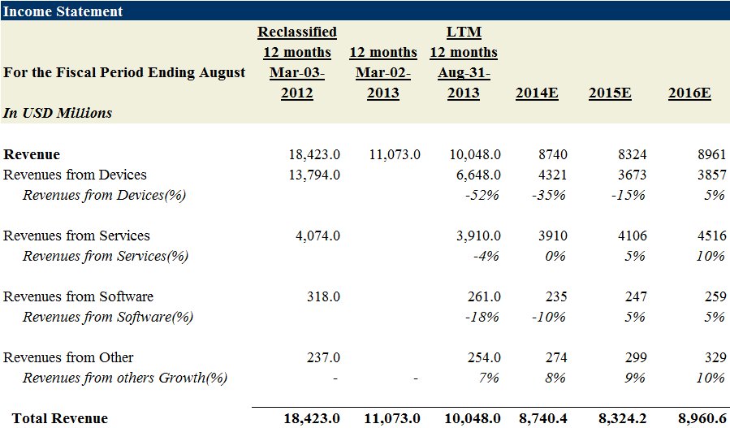
Revenue Projections

Slide 25
Income Statement Projections
Key Financials¹
For the Fiscal Period Ending | 12 months Mar-02-2013A | LTM² 12 months Aug-31-2013A | 12 months† Aug-28-2014E | 12 months Aug-31-2015E | 12 months Aug-31-2016E
Currency | USD | USD | USD | USD | USD
Total Revenue | 11,073.0 | 10,048.0 | 8740.42 | 8,324.2 | 8,960.6
Growth Over Prior Year | (39.9%) | (33.1%) | (13.01%) | (4.76%) | 7.65%
Gross Profit | 3,530.0 | 2,678.0 | 2796.93 | 2746.98 | 2867.39
Margin % | 31.9% | 26.7% | 32.00% | 33.00% | 32.00%
EBITDA | 1,238.0 | 156.0 | 1,055.7 | 1,005.7 | 1,126.1
Margin % | 11.2% | 1.6% | 12.1% | 12.1% | 12.6%
EBIT | (680.0) | (1,525.0) | 485.28 | 435.3 | 555.7
Margin % | (6.1%) | (15.2%) | 5.55% | 5.23% | 6.20%
Earnings from Cont. Ops. | (628.0) | (938.0) | 93.17 | 134.0 | 260.2
Margin % | (5.7%) | (9.3%) | 1.07% | 1.61% | 2.90%
Net Income | (646.0) | (942.0) | 93.2 | 134.0 | 260.2
Margin % | (5.8%) | (9.4%) | 1.1% | 1.6% | 2.9%

Slide 26
Measures to measure turnaround success
Success Metrics
Increase in Revenues
Devices
Services
Profits
Altman Z value
Increase in Brand perception
Employee satisfaction
Return on Equity
Notes:
Develop software apps to support customers in IOS and Android as it Difficult to build app ecosystem

Slide 27
Questions?
Managing Turnaround Companies

Slide 28
Exhibits
 | Liquidation Value | %
Cash | 2,344.0
A/R | 1,699.60 | 70%
Inventory | 141.15 | 15%
Net PP&E | 529.75 | 25%
Other Intangibles | 1,051.5 | 30%
Total Liquidation Value | 5,766.0

Slide 29
BlackBerry Limited Financial Key Stats
Income Statement
For the Fiscal Period Ending | Reclassified 12 months Mar-03-2012 | 12 months Mar-02-2013 | LTM 12 months Aug-31-2013 | 2014 LTM | 2015 LTM | 2016 LTM
Currency | USD | USD | USD | USD | USD | USD
Revenue | 18,423.0 | 11,073.0 | 10,048.0 | 8740 | 8324 | 8961
Revenues from Devices | 13,794.0 |  | 6,648.0 | 4321 | 3673 | 3857
Revenues from Devices(%) |  |  | -52% | -35% | -15% | 5%
Revenues from Services | 4,074.0 |  | 3,910.0 | 3910 | 4106 | 4516
Revenues from Services(%) |  |  | -4% | 0% | 5% | 10%
Revenues from Software | 318.0 |  | 261.0 | 235 | 247 | 259
Revenues from Software(%) |  |  | -18% | -10% | 5% | 5%
Revenues from Other | 237.0 |  | 254.0 | 274 | 299 | 329
Revenues from others Growth(%) | - | - | 7% | 8% | 9% | 10%
Total Revenue | 18,423.0 | 11,073.0 | 10,048.0 | 8,740.4 | 8,324.2 | 8,960.6
Key Financials¹
For the Fiscal Period Ending |  | 12 months Mar-02-2013A | LTM² 12 months Aug-31-2013A | 12 months† Aug-28-2014E | 12 months Aug-31-2015E | 12 months Aug-31-2016E
Currency |  | USD | USD | USD | USD | USD
Total Revenue |  | 11,073.0 | 10,048.0 | 8740.42 | 8,324.2 | 8,960.6
Growth Over Prior Year |  | (39.9%) | (33.1%) | (13.01%) | (4.76%) | 7.65%
Gross Profit |  | 3,530.0 | 2,678.0 | 2796.93 | 2746.98 | 2867.39
Margin % |  | 31.9% | 26.7% | 32.00% | 33.00% | 32.00%
EBITDA |  | 1,238.0 | 156.0 | 1,055.7 | 1,005.7 | 1,126.1
Margin % |  | 11.2% | 1.6% | 12.1% | 12.1% | 12.6%
EBIT |  | (680.0) | (1,525.0) | 485.28 | 435.3 | 555.7
Margin % |  | (6.1%) | (15.2%) | 5.55% | 5.23% | 6.20%
Earnings from Cont. Ops. |  | (628.0) | (938.0) | 93.17 | 134.0 | 260.2
Margin % |  | (5.7%) | (9.3%) | 1.07% | 1.61% | 2.90%
Net Income |  | (646.0) | (942.0) | 93.2 | 134.0 | 260.2
Margin % |  | (5.8%) | (9.4%) | 1.1% | 1.6% | 2.9%

Slide 30
Income Statement
For the Fiscal Period Ending | Reclassified 12 months Mar-03-2012 | 12 months Mar-02-2013 | LTM 12 months Aug-31-2013 | 2014 LTM | 2015 LTM | 2016 LTM
Currency | USD | USD | USD | USD | USD | USD
Revenue | 18,423.0 | 11,073.0 | 10,048.0 | 8740 | 8324 | 8961
Revenues from Devices | 13,794.0 |  | 6,648.0 | 4321 | 3673 | 3857
Revenues from Devices(%) |  |  | -52% | -35% | -15% | 5%
Revenues from Services | 4,074.0 |  | 3,910.0 | 3910 | 4106 | 4516
Revenues from Services(%) |  |  | -4% | 0% | 5% | 10%
Revenues from Software | 318.0 |  | 261.0 | 235 | 247 | 259
Revenues from Software(%) |  |  | -18% | -10% | 5% | 5%
Revenues from Other | 237.0 |  | 254.0 | 274 | 299 | 329
Revenues from others Growth(%) | - | - | 7% | 8% | 9% | 10%
Total Revenue | 18,423.0 | 11,073.0 | 10,048.0 | 8,740.4 | 8,324.2 | 8,960.6
Cost Of Goods Sold | 11,834.0 | 7,543.0 | 7,370.0 | 5943.5 | 5577.2 | 6093.2
 | 64% | 68% | 73% | 68% | 67% | 68%
Gross Profit | 6,589.0 | 3,530.0 | 2,678.0 | 2,796.9 | 2,747.0 | 2,867.4
Selling General & Admin Exp. | 2,512.0 | 2,014.0 | 2,040.0 | 2,040.0 | 2,244.0 | 2,244.0 | 10%
R & D Exp. | 1,533.0 | 1,482.0 | 1,450.0 | 1,305.0 | 1,305.0 | 1,305.0 | 90%
Depreciation & Amort. | - | - | -
Amort. of Goodwill and Intangibles | 567.0 | 714.0 | 713.0 | 570.40 | 570.40 | 570.40 | 80%
Other Operating Expense/(Income) | - | - | -
Other Operating Exp., Total | 4,612.0 | 4,210.0 | 4,203.0 | 2,311.7 | 2,311.7 | 2,311.7 | 55%
Operating Income | 1,977.0 | (680.0) | (1,525.0) | 485.3 | 435.3 | 555.7
Interest Expense | - | - | -
Interest and Invest. Income | 21.0 | 15.0 | 12.0 | 12.0 | 12.0 | 12.0
Net Interest Exp. | 21.0 | 15.0 | 12.0 | 12.0 | 12.0 | 12.0
Other Non-Operating Inc. (Exp.) | - | - | -
EBT Excl. Unusual Items | 1,998.0 | (665.0) | (1,513.0) | 473.3 | 423.3 | 543.7
Restructuring Charges | (125.0) | (220.0) | (318.0) | (318.0) | (200.0) | (110.0)
Impairment of Goodwill | (355.0) | (335.0) | 0
Gain (Loss) On Sale Of Invest. | - | - | (1.0)
Legal Settlements | - | - | -
Other Unusual Items | - | - | -
EBT Incl. Unusual Items | 1,518.0 | (1,220.0) | (1,832.0) | 155.3 | 223.3 | 433.7
Income Tax Expense | 347.0 | (592.0) | (894.0) | 62.11 | 89.33 | 173.50 | 40%
Earnings from Cont. Ops. | 1,171.0 | (628.0) | (938.0) | 93.2 | 134.0 | 260.2

